Slide 1
Arrays in java

Slide 2
Java Array
Normally, array is a collection of similar type of elements that have contiguous memory location.
Java array is an object that contains elements of similar data type. It is a data structure where we store similar elements. We can store only fixed set of elements in a java array.
Array in java is index based, first element of the array is stored at 0 index.
Arrays in Java work differently than they do in C/C++.

Slide 3
Some important point about Java arrays
In Java all arrays are dynamically allocated.(discussed below)
Since arrays are objects in Java, we can find their length using member length. This is different from C/C++ where we find length using sizeof.
A Java array variable can also be declared like other variables with [] after the data type.
The variables in the array are ordered and each have an index beginning from 0.
Java array can be also be used as a static field, a local variable or a method parameter.
The size of an array must be specified by an int value and not long or short.
The direct superclass of an array type is Object.
Every array type implements the interfaces Cloneable and java.io.Serializable.

Slide 4
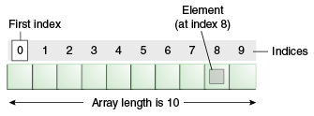

Slide 5
Advantage of Java Array
Code Optimization: It makes the code optimized, we can retrieve or sort the data easily.
Random access: We can get any data located at any index position.

Slide 6
Disadvantage of Java Array
Size Limit: We can store only fixed size of elements in the array. It doesn't grow its size at runtime. To solve this problem, collection framework is used in java.

Slide 7
Types of Array in java
There are two types of arrays:
Single Dimensional Array
Multidimensional Array

Slide 8
Single Dimensional Array in java
Syntax to Declare an Array in java
dataType[] arr; (or)
dataType []arr; (or)
dataType arr[];
Instantiation of an Array in java
arrayRefVar=new datatype[size];

Slide 9
Example of single dimensional java array
class Testarray{
public static void main(String args[])
{
int a[]=new int[5];//declaration and instantiation
a[0]=10;//initialization
a[1]=20;
a[2]=70;
a[3]=40;
a[4]=50;
//printing array
for(int i=0;i<a.length;i++)//length is the property of array
System.out.println(a[i]);
}}
Output: 10 20 70 40 50

Slide 10
Declaration, Instantiation and Initialization of Java Array
class Testarray1{
public static void main(String args[]){
int a[]={33,3,4,5};//declaration, instantiation and initialization
//printing array
for(int i=0;i<a.length;i++)//length is the property of array
System.out.println(a[i]);
}}
Output:33 3 4 5
We can declare, instantiate and initialize the java array together by:
Syntax
int a[]={33,3,4,5};//declaration, instantiation and initialization

Slide 11
Passing Array to method in java
class Testarray2{
static void min(int arr[]){
int min=arr[0];
for(int i=1;i<arr.length;i++)
if(min>arr[i])
min=arr[i];
System.out.println(min);
}
public static void main(String args[]){
int a[]={33,3,4,5};
min(a);//passing array to method
}}

Slide 12
Multidimensional array in java
Example of Multidimensional java array
class Testarray3{
public static void main(String args[]){
//declaring and initializing 2D array
int arr[][]={{1,2,3},{2,4,5},{4,4,5}};
//printing 2D array
for(int i=0;i<3;i++){
for(int j=0;j<3;j++){
System.out.print(arr[i][j]+" ");
}
System.out.println();
}
}}
Syntax to Declare Multidimensional Array in java
dataType[][] arrayRefVar; (or)
dataType [][]arrayRefVar; (or)
dataType arrayRefVar[][]; (or)
dataType []arrayRefVar[];

Slide 13
Addition of 2 matrices in java
class Testarray5{
public static void main(String args[]){
//creating two matrices
int a[][]={{1,3,4},{3,4,5}};
int b[][]={{1,3,4},{3,4,5}};
//creating another matrix to store the sum of two matrices
int c[][]=new int[2][3];
//adding and printing addition of 2 matrices
for(int i=0;i<2;i++){
for(int j=0;j<3;j++){
c[i][j]=a[i][j]+b[i][j];
System.out.print(c[i][j]+" ");
}
System.out.println();//new line
}
}}
Output:2 6 8
6 8 10

Slide 14
Array Members
Now as you know that arrays are object of a class and direct superclass of arrays is class Object. The members of an array type are all of the following:
The public final field length, which contains the number of components of the array. length may be positive or zero.
All the members inherited from class Object; the only method of Object that is not inherited is its clone method.
The public method clone(), which overrides clone method in class Object and throws no checked exceptions.

Slide 15
Cloning of arrays
// Java program to demonstrate // cloning of one-dimensional arrays class Test { public static void main(String args[]) { int intArray[] = {1,2,3}; int cloneArray[] = intArray.clone(); // will print false as deep copy is created // for one-dimensional array System.out.println(intArray == cloneArray); for (int i = 0; i < cloneArray.length; i++) { System.out.print(cloneArray[i]+" "); } } }
When you clone a single dimensional array, such as Object[], a "deep copy" is performed with the new array containing copies of the original array's elements as opposed to references.
Output:
false 1 2 3

Slide 16
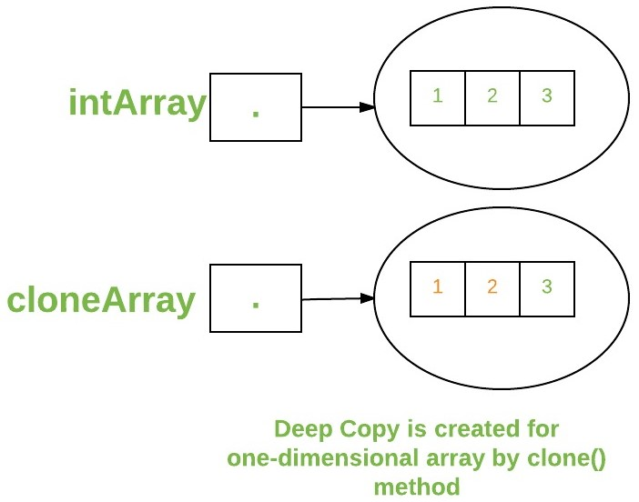

Slide 17
Cloning of arrays
// Java program to demonstrate // cloning of multi-dimensional arrays class Test { public static void main(String args[]) { int intArray[][] = {{1,2,3},{4,5}}; int cloneArray[][] = intArray.clone(); // will print false System.out.println(intArray == cloneArray); // will print true as shallow copy is created // i.e. sub-arrays are shared System.out.println(intArray[0] == cloneArray[0]); System.out.println(intArray[1] == cloneArray[1]); } }
A clone of a multidimensional array (like Object[][]) is a "shallow copy" however, which is to say that it creates only a single new array with each element array a reference to an original element array but subarrays are shared.
Output:
false true true

Slide 18
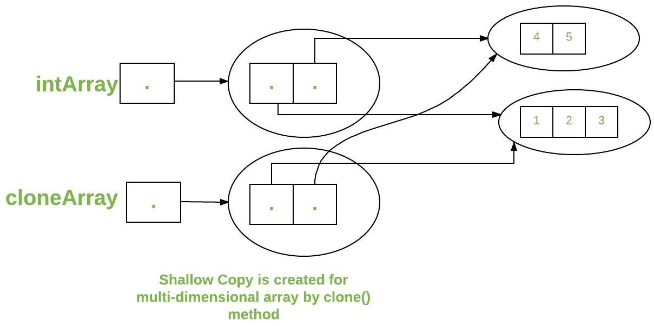

Slide 19
Interview questions
What is Iterating over Arrays in Java
What is Anonymous array in Java
Difference Array vs ArrayList in Java
How to copy an array into another array?(4 types )
What are “jagged” arrays in java?
When ArrayIndexOutOfBoundsException occurs?
Can you store String in an array of Integer in Java? compile time error or runtime exception?
Difference between a[] and []a in Java?

Slide 20
End of Session - 5 Thank You !

